Slide 1
Capstone Project Restaurant Recommendation
Anqi Jiao

Slide 2
Goal of the recommendation system
The mission of this recommendation system is to find the best possible restaurant by type. This system will provide visitors with a list of related restaurants located in featured area (most popular location of a specific type of restaurant) in Manhattan.

Slide 3
Data source of the recommendation system
The information for each restaurant is collected form "Foursquare". The basic information for each restaurant includes the name of restaurant, the venue ID of restaurant, the latitude and longtitude of restaurant, and zip code of restaurant. After gathering the basic information, we know the basic statistics of restaurant types and zip code. These information allow us to identify the most located area for a specific type of restaurant.
To give the best possible recommendation for a type of restaurant, we pick one with a selected zip code. This restaurant should be one of the most authentic one by type. Next, we use the venue ID of restaurant to extract information about the quality of food, customer rating. The advanced information assists the visitor's decision making.

Slide 4
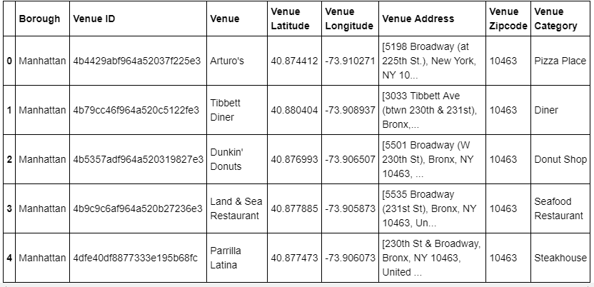
A quick look of the restaurant data

Slide 5
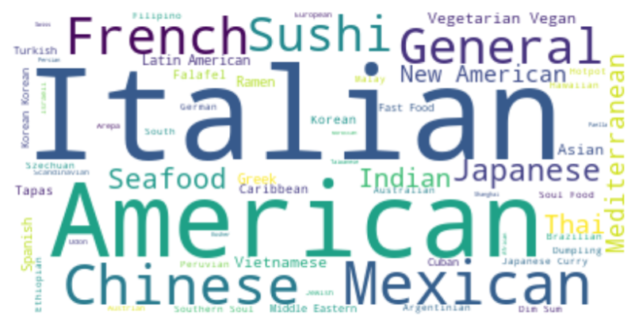
Visualize the most popular restaurant types

Slide 6
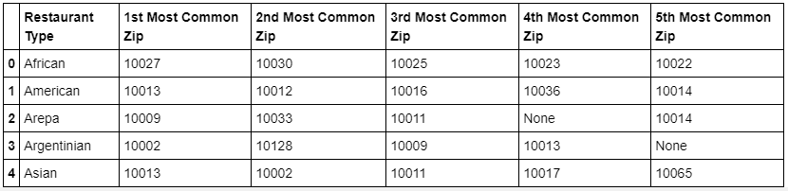
A quick look of the restaurant type and zip code

Slide 7
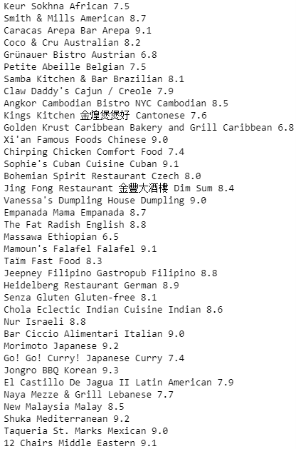
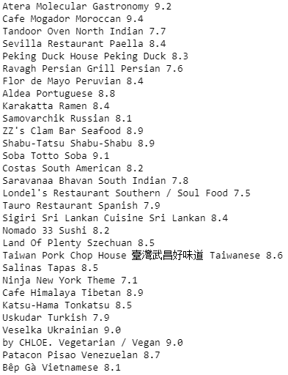
A brief list of featured restaurants

